Slide 1
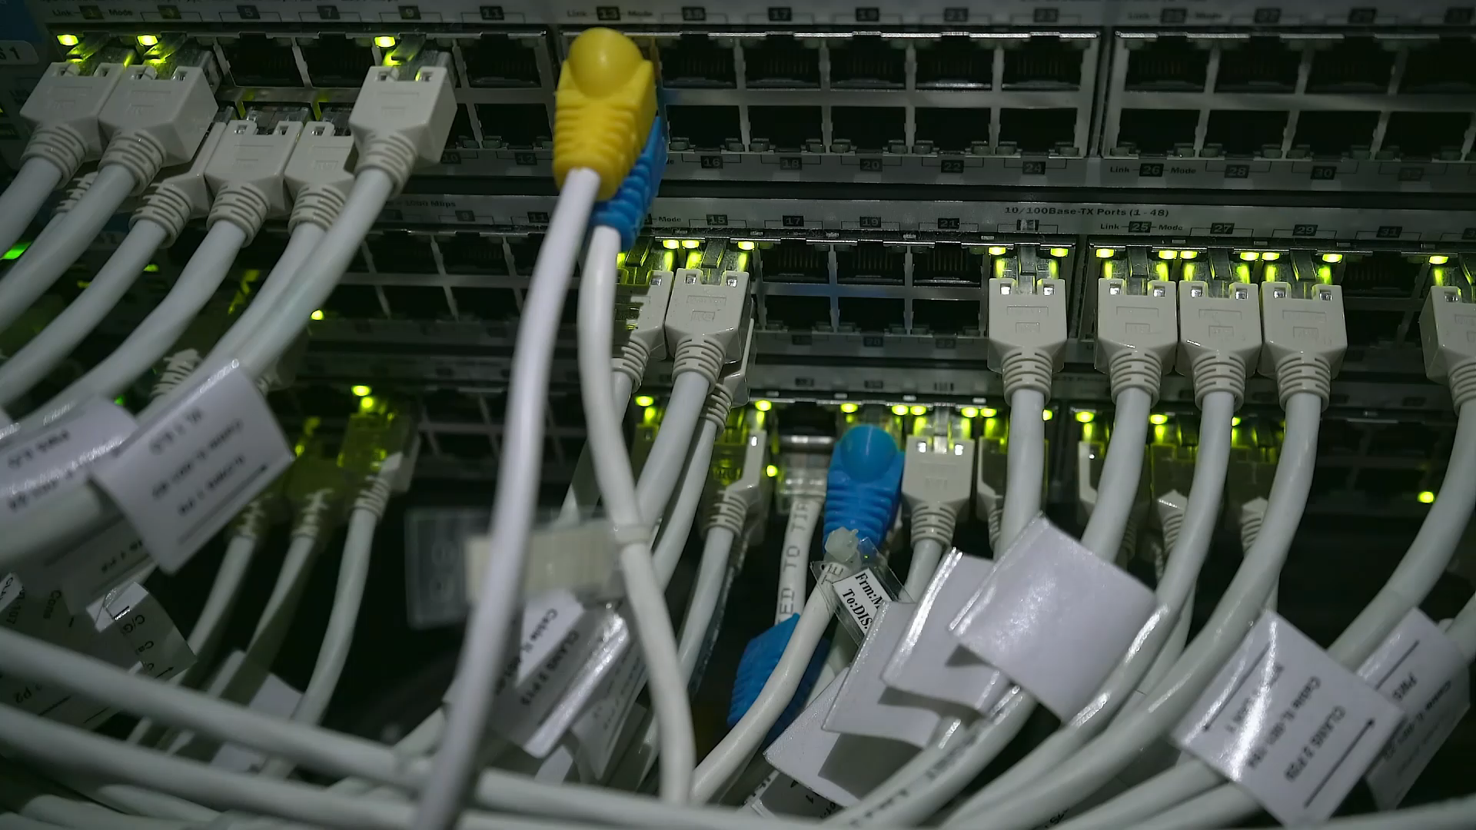
Network Implementation –Acme.com By : Ramsey Lewis

Slide 2
Case Study Scenario for Acme
Acme is a mid-sized business in Southern England that specializes in offering office equipment to customers. They also provide sales and customer support services. The company runs five shops in Bournemouth, Swindon, Southampton, Reading, and Portsmouth, there are 180 staffs in each shop has 30 staffs the company has also 30 additional staff standby in the head office that will be needing access to the computer.

Slide 3

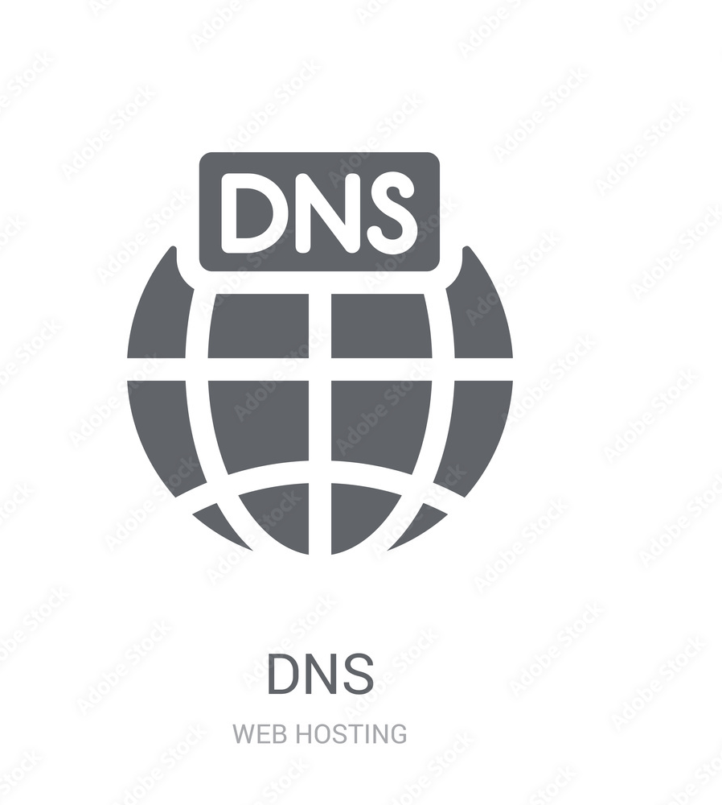

Types of servers in the networks
DHCP Server
DNS Server
Web Server

Slide 4
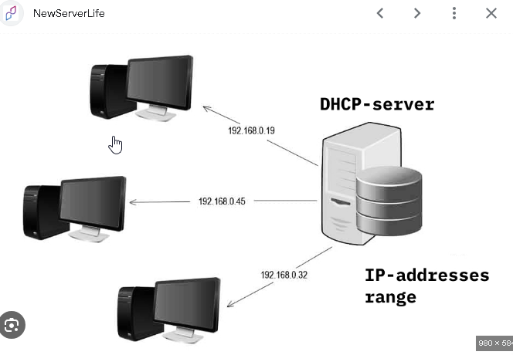
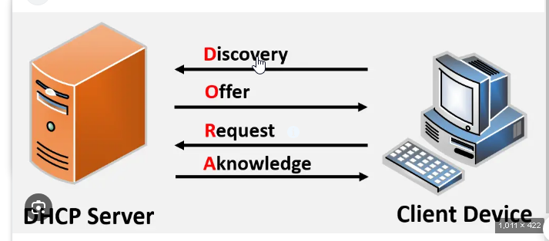
Building DHCP Server
When building a DHCP server for ACME, we need to define the IP address range and subnets for each of the company’s five locations, ensuring these are connected through a central network over WAN links. This setup will establish reliable connectivity across sites. We will also configure the Beer, J. (2018). DHCP server to assign dynamic IPs to workstations Beer, J. (2018). while reserving static IPs for servers and critical devices, as specified in ACME’s requirements. To meet ACME’s needs, we could select either a Windows Server DHCP or ISC DHCP for Linux, depending on the existing infrastructure and preference for integration or flexibility. The DHCP server will also support ACME’s secure wireless LAN, allowing mobile devices like laptops and tablets to connect seamlessly across sites. This setup will provide centralized control, scalability for future expansion, and efficient management of IP addresses, fully supporting ACME’s network requirements.

Slide 5
To meet case study ACME’s requirements for 1 ,2 and 3 it’s essential to select a DHCP server that allows centralized management of DHCP scopes from a single location. Each site would need a unique DHCP scope based on its designated subnet, ensuring that devices receive IP addresses specific to their location. This setup supports organized IP allocation, which aligns with the requirements for efficient network management and connectivity across all sites.
For Example of Location with their specific scopes:
Bournemouth: 175.168.1.0
Southampton: 175.168.2.0
Portsmouth: 175.168.3.0
Swindon: 175.168.4.0
Reading: 175.168.5.0

Slide 6
For requirements 1,3 and 7 We also need to set up a back up system called fail over would be essential for the DHCP Server example if one dhcp server fails the other server can take over we would need to consider setting up server such as cloud in a different location of the company
https://www.youtube.com/watch?v=S7Eh7ubTVtY
Notes:
https://www.youtube.com/watch?v=S7Eh7ubTVtY

Slide 7
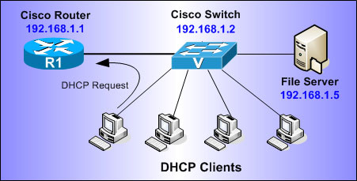
Once the DHCP server has been set up for Acme, thorough testing the Ip addresses is essential to ensure that it functions correctly across all five locations of the company. Testing will confirm that each site’s DHCP scope is configured accurately and that IP addresses are being allocated as intended.
(www.firewall.cx, n.d.)
Notes:
www.firewall.cx. (n.d.). How To Configure DHCP Server On A Cisco Router. [online] Available at: https://www.firewall.cx/cisco/cisco-routers/cisco-router-dhcp-config.html.
‌

Slide 8
Building a Dns Server
For requirement 3,6 and 7 we would be required to build Dns Server we need to install a primary Dns that would be for once server for main site of the company and the other backup Dns would be for the other through this process it would keep the network running smoothly also for employees for example would need to position the Dns server tactfully in other location to reduce latency for the people or employee using the network for accessing documents and other different information from the different sites of the company.

Slide 9
DNS Server
There are alternative option For installing and configuring DNS Server is in windows server on the Active directory as it easier for the company to use windows based server
First We need to go to the Server Manager
Add roles and features
Then we need to select our server as for the case for example acme.com and then select DNS to install the DNS
DNS will be installed and DNS server can be used
Notes:
Explain why the network upgrade is crucial for Acme, touching on current limitations and expected improvements.

Slide 10
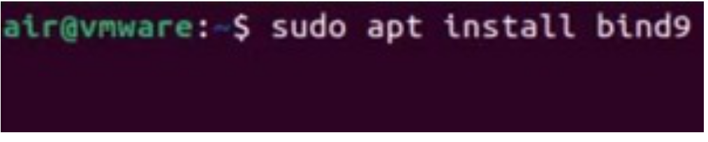
To set up the Dns
For the hardware requirement we would need virtual machine or computer running a dns Server You would also need to make sure static Ip address is added
The software requirement for using dns would be the Windows Server or Linux by installing the package called bind

Slide 11
Building Web Server
Because Acme requires in requirement 4,5 and 7 outlined in the case study it particularly those related to hosting public website for example like web server at Bournemouth site would allow customers and other sites to be able to be accessible but in the other hand there is also disadvantages which would be the latency concerns of high traffic loads with slow response time because of overloaded users to solve this we would need cloud based fail over solutions and an internal intranet
Notes:
Explain why the network upgrade is crucial for Acme, touching on current limitations and expected improvements.

Slide 12
(Gcore, n.d.) We can set up web Server using ubuntu this resource of website will help to install web server in ubuntu
(Gcore, n.d.)
Or
We can set up Web server in Windows server in the active directory
Notes:
Gcore. (n.d.). How to Set Up a Basic Web Server on Ubuntu | Step-by-step Guide. [online] Available at: https://gcore.com/learning/setting-up-basic-web-server-ubuntu/.
www.youtube.com. (n.d.). IIS Web Server Installation & Website Configuration | Introduction to Windows Server 2016 Course. [online] Available at: https://www.youtube.com/watch?v=gEn8j9vkaMU.
‌
‌

Slide 13
Conclusion
In conclusion, the recommended network infrastructure not only fulfills but also achieve the Acme’s goals and requirements as explained above slides

Slide 14
References
Shutterstock. (2015). 75 Dhcp Stock Vectors and Vector Art | Shutterstock. [online] Available at: https://www.shutterstock.com/search/dhcp?image_type=vector
Pngegg.com. (2024). Web Server illustration, Web server Computer Servers Web hosting service Data center, server, computer Network, electronics png | PNGEgg. [online] Available at: https://www.pngegg.com/en/png-zsiwz
NewServerLife. (n.d.). What is DHCP server and how to configure IT | newserverlife.com. [online] Available at: https://newserverlife.com/articles/what-is-dhcp-server-and-how-to-configure-it/.
Beer, J. (2018). Installing and Configuring Active Directory – Windows Server 2016. [online] www.readandexecute.com. Available at: https://www.readandexecute.com/how-to/server-2016/active-directory/how-to-server-2016installing-active-directory-server-2016/.
Blackburn in Tech (2024). Setting Up Your Own DNS Server: Building a BIND9 Server on Ubuntu! [online] YouTube. Available at: https://www.youtube.com/watch?v=6mfEYAkDwRs
www.firewall.cx. (n.d.). How To Configure DHCP Server On A Cisco Router. [online] Available at: https://www.firewall.cx/cisco/cisco-routers/cisco-router-dhcp-config.html.
‌‌https://www.parkplacetechnologies.com/blog/what-is-dhcp-how-works-benefits/
Gcore. (n.d.). How to Set Up a Basic Web Server on Ubuntu | Step-by-step Guide. [online] Available at: https://gcore.com/learning/setting-up-basic-web-server-ubuntu/.
‌

